Slide 1

Housing Case Study Exploratory Data Analysis (EDA)
Mohammed Abdul Rahman DA/DS
March 2025 - Online

Slide 2

INTRODUCTION
Project focuses on EDA of housing dataset.
Objective: Uncover factors influencing house prices.
Tools: Python libraries (Pandas, Seaborn, Matplotlib).
Outcome: Transform raw data into actionable insights for real estate stakeholders.

Slide 3

Project Workflow
Data Understanding
Data Cleaning
Insights
Feature
Engineer
Data Analysis

Slide 4

Data Understanding
Dataset: housing.csv
Shape: 4,600 rows × 18 columns
Attributes: Date, Price, Bedrooms, Bathrooms, Sqft_living, Sqft_lot, Floors, Waterfront, View, Condition, Sqft_above, Sqft_basement, Yr_built, Yr_renovated, Street, City, Statezip, Country
Issues: Null values, outliers, incorrect data types.
Dataset comprehensive enough for detailed price analysis.
Problem Statement:
Clarify the complex factors that drive real estate prices to help buyers, sellers, and policymakers make informed decisions.

Slide 5

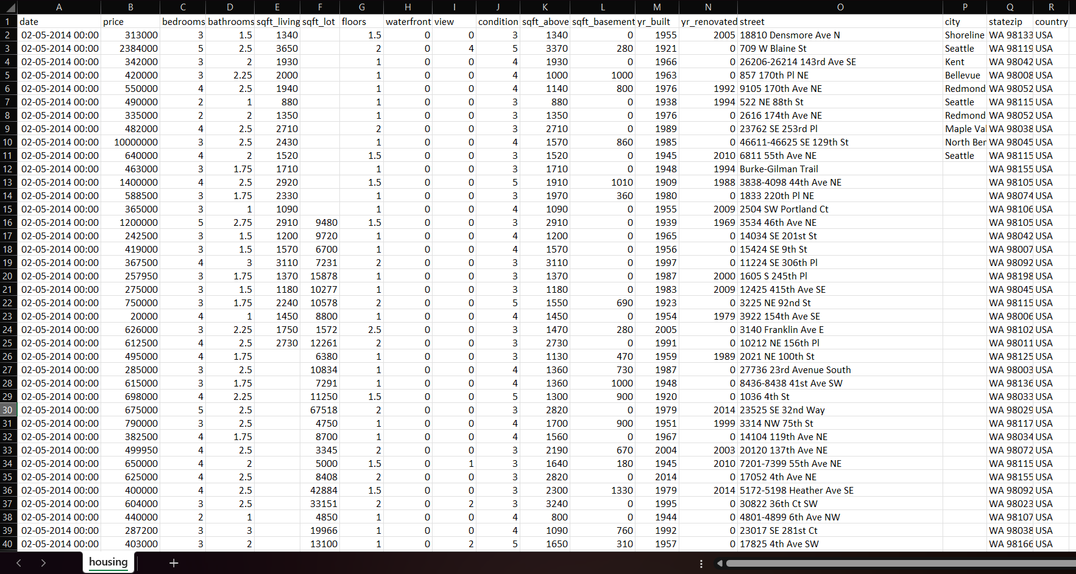
Dataset Screenshot

Slide 6

Data Cleaning
Checked unique values for inconsistencies.
Standardization: Converted date to datetime, encoded categorical features.
Imputed missing values (mean for numerical, mode for categorical).
Removed outliers (IQR method).
Dropped redundant column: waterfront.

Slide 7
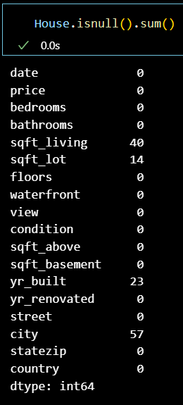
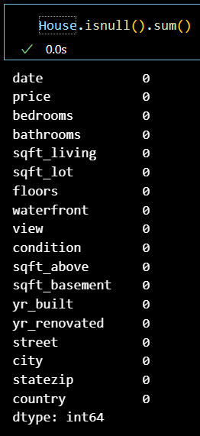
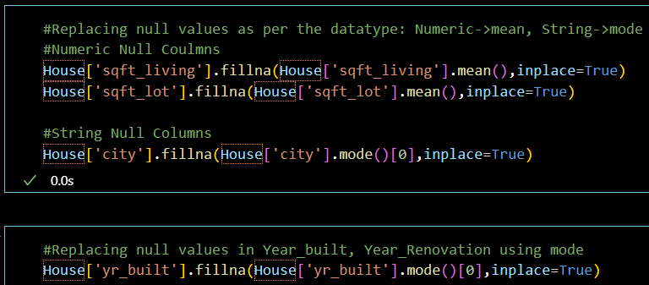
Dataset Cleaning Process

Slide 8

Handling Missing Values
Numerical Columns (sqft_living, sqft_lot) → Imputed with mean.
Categorical Columns (city, yr_built) → Imputed with mode.
Ensured dataset completeness without bias.

Slide 9

Outlier Handling
Detected using box plots & IQR method.
Outliers found in: Price, Bedrooms, Bathrooms, Sqft_living, Sqft_lot, Sqft_above, Sqft_basement.
Removed extreme values (e.g., bedrooms >6, sqft_living >2920).
Improved dataset reliability.

Slide 10
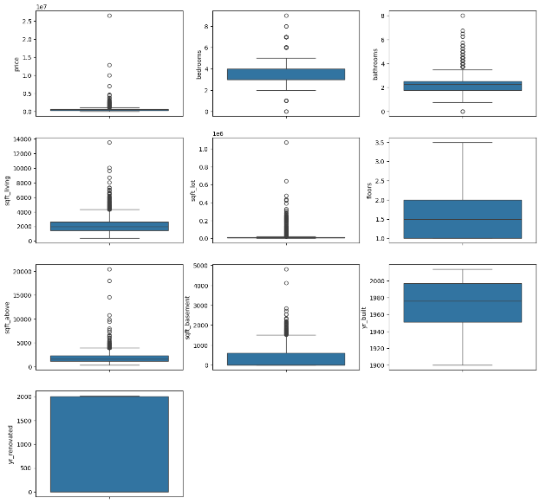
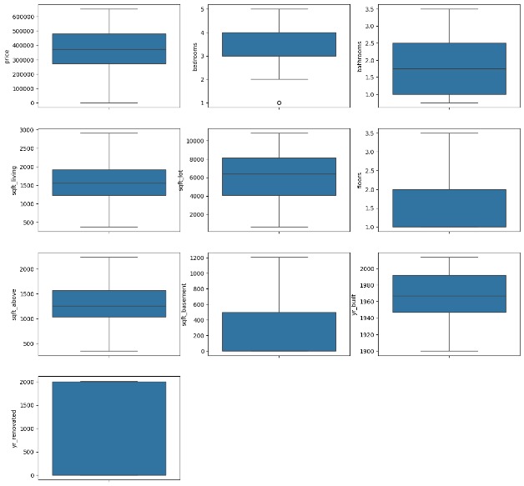
Outliers Box Plots
Boxplot with Outliers
Boxplot without Outliers

Slide 11

Handling Invalid Values
Converted incorrect data types (e.g., date).
Standardized categorical values (0/1 → Yes/No for waterfront).
Removed redundant/uninformative columns.
Final dataset ensured accuracy & consistency.

Slide 12

Feature Engineering
To enhance the analytical power of the dataset, several new features were engineered. These derived metrics offer more direct insights into a property's age, renovation status, and potential influence on its price.
Feature Engineering Done:
House Age
Renovation Age
Month from Date Column
Price per Square Foot

Slide 13

Statistical Analysis
Descriptive Stats:
Mean, Median, Mode, Std. Deviation for Price, Bedrooms, Lot Size, etc.
Hypothesis Tests:
Chi-Square Test: No association between View & Condition.

Slide 14

Descriptive Analysis
Avg House Price: ₹378K (Median: ₹372.5K, Mode: ₹300K).
Avg Sqft_living: ~1573 sqft.
Most common lot size: 5000 sqft.
Most houses: 3 bedrooms, 2 bathrooms.
Price per sqft: Avg ₹254.

Slide 15
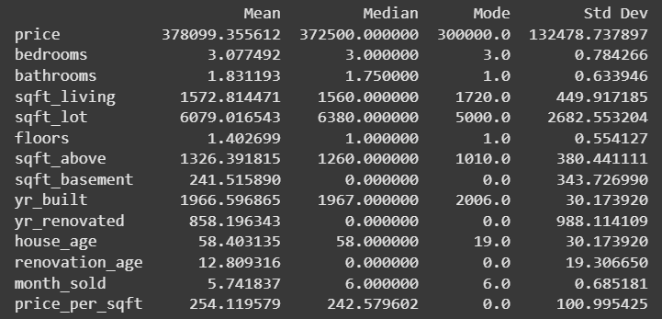
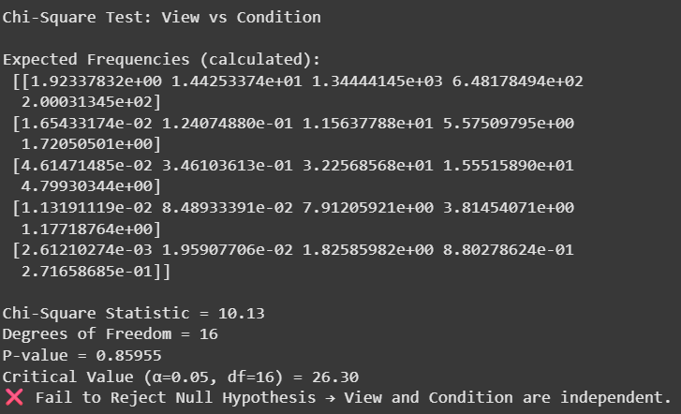
Statistical Analysis

Slide 16

Relationships Between Variables
Positive correlation: Price ↔ Sqft_living, Sqft_above, Sqft_basement.
Weak correlation: Bedrooms & Bathrooms with Price.
Independent: View not strongly linked with Price.
Seasonal Trend: July peak in prices.

Slide 17

Data Visualization
Importance: Reveals patterns & insights beyond raw stats.
Visuals Used: Histograms, Count Plots, Box Plots, Scatter Plots, Line Graphs, Heatmaps, Pairplots.
Helped confirm relationships & detect anomalies.

Slide 18

Univariate Analysis
Univariates Analysis Done:
Histogram Plot for 'Price’ → Right-skewed (most houses ~₹250K).
Count Plot for Bedrooms → Majority: 3 bedrooms.
Count Plot for Condition → Most houses rated 3 (average).
Box Plot for 'Sqft Living’ → Median ~1500 sqft.

Slide 19
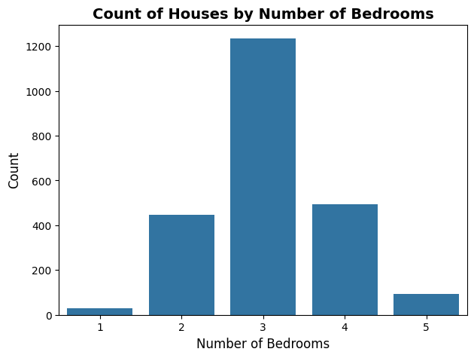
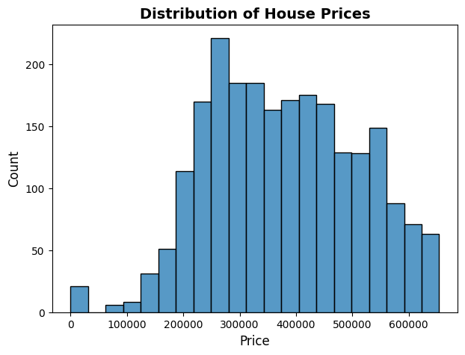
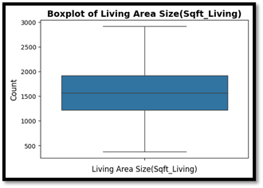
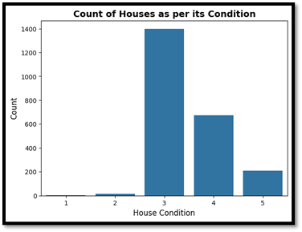
Univariate Analysis

Slide 20

Bivariate Analysis
Bivariate Visualizations Done:
Scatter Plot for 'Sqft_living vs price’ → Strong positive trend.
Box Plot for 'view vs Price’ → No strong relationship.
Bar Plot for 'condition vs bathrooms’ → Avg bathrooms increase with better condition.
Scatter Plot for 'Price vs Number of bedrooms’ → Weak positive correlation.
House Price Trend Over Months → Prices peak in July.

Slide 21
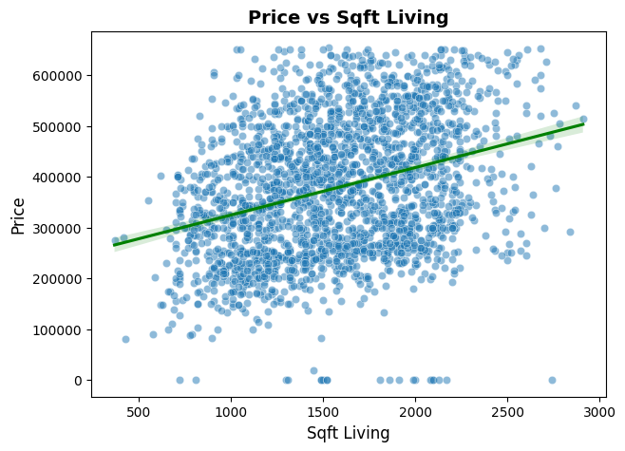
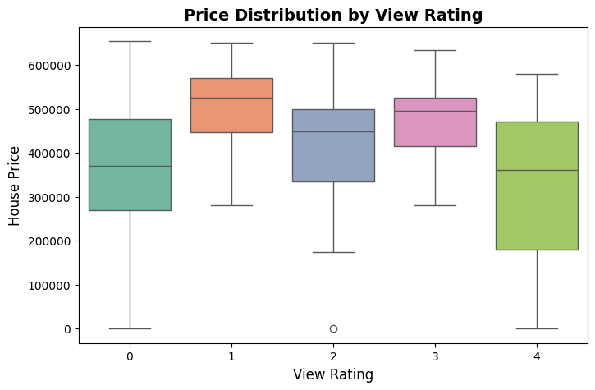
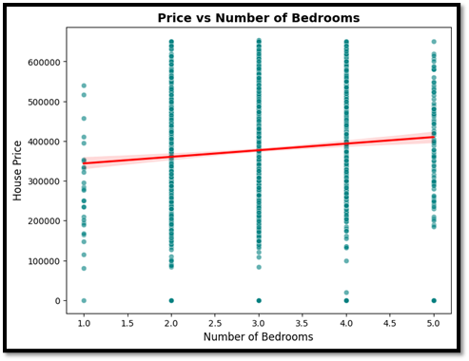
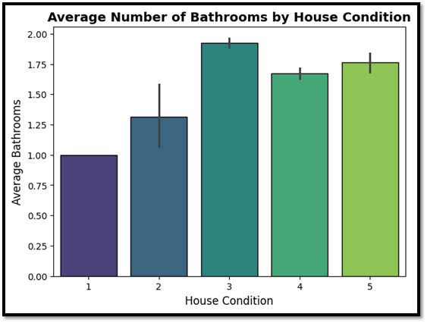
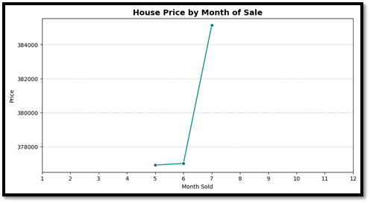
Bivariate Analysis

Slide 22

Multivariate Analysis
Multivariate Visualizations Done:
Pairplot: Price strongly linked with sqft_living & sqft_above.
Heatmap: Price correlation → Sqft_living (0.70), Grade (0.67).
Bedrooms & Bathrooms → weaker correlation.
Price distribution → Right-skewed, driven by outliers.

Slide 23
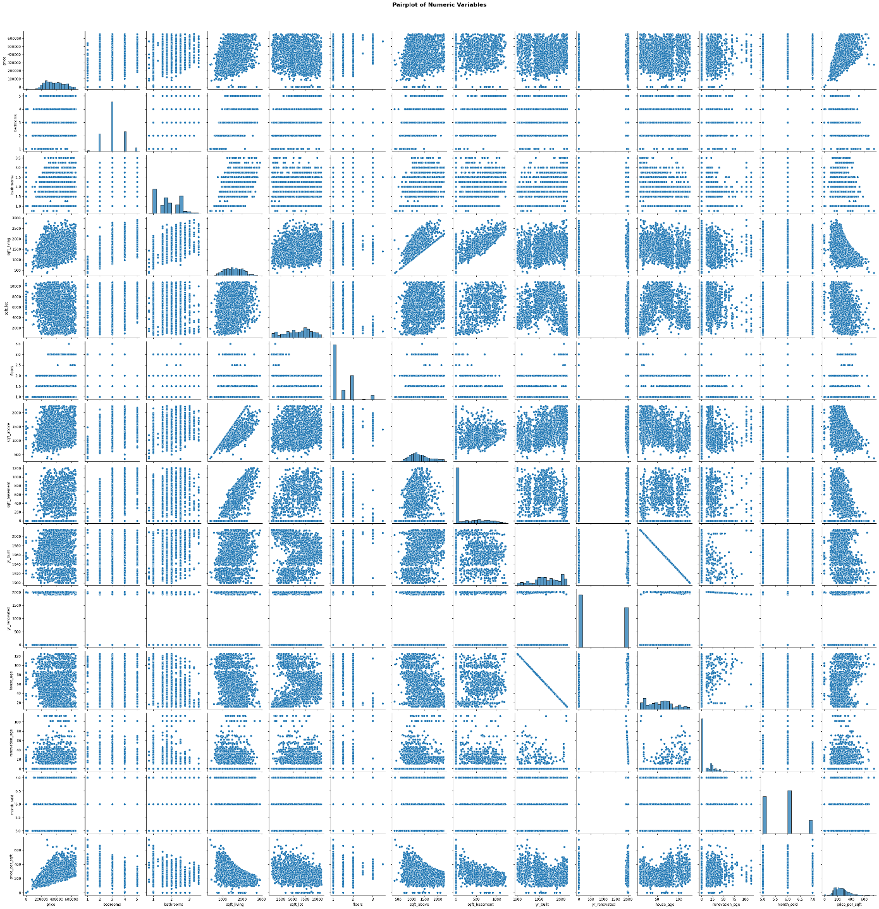
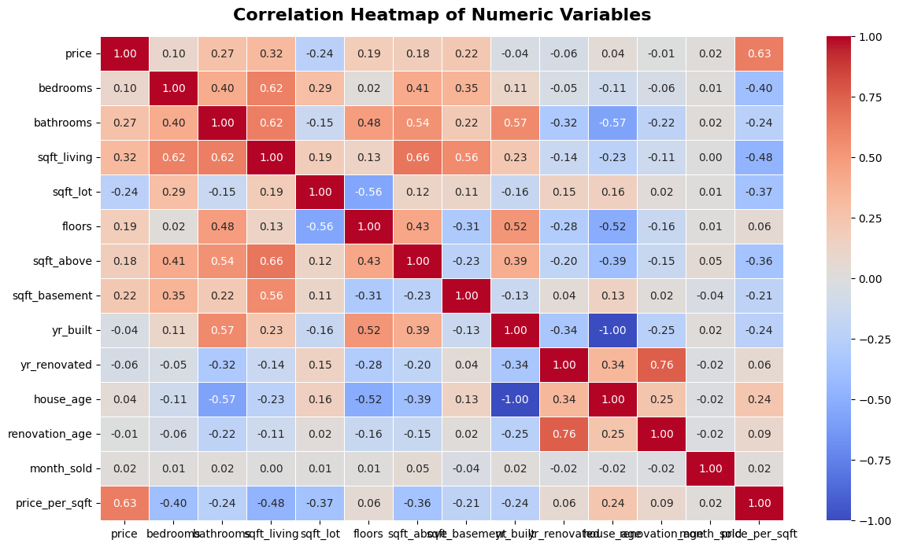
Multivariate Analysis

Slide 24

Conclusion
This study confirms that house prices are driven mainly by property size, especially living area. Additional factors like above-ground space and renovations contribute more strongly than bedrooms or bathrooms. The market shows seasonal variation, with notable price peaks in July.
Overall, these insights can guide smarter buying, selling, and future predictive modeling in real estate.
Key Findings:
Living Area is the strongest determinant of Price.
Sqft_above > Sqft_basement in impact.
Bedrooms & Bathrooms have weaker influence.
Seasonal spikes observed in July.
Recommendations:
Buyers should focus on size & condition over view.
Sellers can leverage living area & renovations to price better.
Future work: Build predictive models for price estimation.

Slide 25

Thank You

